Slide 1

Data Mining
CS-772
Department of
Computer Sciences

Slide 2
Association Rule
Mining

Slide 3
Association Rules
Unlike classification, the left- and right-hand sides of rules can potentially include tests on the value of any attribute or combination of attributes,
Subject only to the obvious constraints that at least one attribute must appear on both sides of every rule and no attribute may appear more than once in any rule.
In practice data mining systems often place restrictions on the rules that can be generated, such as the maximum number of terms on each side.

Slide 4
Association Rule
If we have a financial dataset one of the rules extracted might be as follows:
IF Has-Mortgage = yes AND Bank Account Status = In credit
THEN Job Status = Employed AND Age Group = Adult under 65
Rules of this more general kind represent an association between the values of certain attributes and those of others and are called association rules.

Slide 5
Association Rule Mining
The process of extracting such rules from a given dataset is called association rule mining (ARM).
The term generalized rule induction (or GRI) is also used, by contrast with classification rule induction.
If we were to apply the constraint that the right-hand side of a rule has to have only one term which must be an attribute/value pair for a designated categorical attribute, association rule mining would reduce to induction of classification rules.

Slide 6
Confidence Value
For a given dataset there are likely to be few if any association rules that are exact, so we normally associate with each rule a confidence value
The proportion of instances matched by its left- and right-hand sides combined as a proportion of the number of instances matched by the left-hand side on its own.
Association Rule Mining algorithms need to be able to generate rules with confidence values less than one.

Slide 7
Low confidence
The number of possible Association Rules for a given dataset is generally very large and a high proportion of the rules are usually of little (if any) value.
For example, for the (fictitious) financial dataset mentioned previously, the rules would include the following:
IF Has-Mortgage = yes AND Bank Account Status = In credit
THEN Job Status = Unemployed
This rule will almost certainly have a very low confidence and is obviously unlikely to be of any practical value.

Slide 8
Computational Efficiency
The main difficulty with association rule mining is computational efficiency.
If there are say 10 attributes,
each rule can have a conjunction of up to nine ‘attribute = value’ terms on the left-hand side. Each of the attributes can appear with any of its possible values.
Any attribute not used on the left-hand side can appear on the right-hand side, also with any of its possible values.
There are a very large number of possible rules of this kind.
Generating all of these is very likely to involve a prohibitive amount of computation, especially if there are a large number of instances in the dataset.
For a given unseen instance there are likely to be several or possibly many rules, probably of widely varying quality, predicting different values for any attributes of interest.
Notes:
Prohibitive : too expensive

Slide 9
Rule Interestingness
In the case of classification rules we are generally interested in the quality of a rule set as a whole.
It is all the rules working in combination that determine the effectiveness of a classifier, not any individual rule or rules.
In the case of association rule mining the emphasis is on the quality of each individual rule.
A single high quality rule linking the values of attributes in a financial dataset or the purchases made by a supermarket customer, say, may be of significant commercial value.
To distinguish between one rule and another we need some measures of rule quality.
These are generally known as rule interestingness measures.

Slide 10
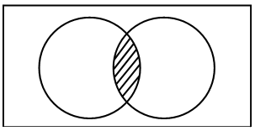
Rule form
if LEFT then RIGHT
Defining four numerical values which can be determined for any rule simply by counting:
N-LEFT Number of instances matching LEFT
N-RIGHT Number of instances matching RIGHT
N-BOTH Number of instances matching both LEFT and RIGHT
N-TOTAL Total number of instances
Instances matching LEFT, RIGHT and both LEFT and RIGHT

Slide 11
Interestingness Measures
The values NLEFT , NRIGHT , NBOTH and NTOTAL are too basic to be considered as rule interestingness measures themselves but the values of most (perhaps all) interestingness measures can be computed from them.
Basic Measures
Confidence (Predictive Accuracy, Reliability)
N-BOTH / N-LEFT
The proportion of right-hand sides predicted by the rule that are correctly predicted
Support
N-BOTH/N-TOTAL
The proportion of the training set correctly predicted by the rule
Completeness
N-BOTH/N-RIGHT
The proportion of the matching right-hand sides that are correctly predicted by the rule

Slide 12
Example
Previous financial rule
IF Has-Mortgage = yes AND Bank Account Status = In credit
THEN Job Status = Employed AND Age Group = Adult under 65
Assume that by counting we arrive at the following values:
N-LEFT = 65 N-RIGHT = 54 N-BOTH = 50 N-TOTAL = 100
From these we can calculate the values of the three interestingness measures as.
Confidence = N-BOTH/N-LEFT = 50/65 = 0.77
Support = N-BOTH/N-TOTAL = 50/100 = 0.5
Completeness = N-BOTH/N-RIGHT = 50/54 = 0.93
The confidence of the rule is 77%, which may not seem very high.
However it correctly predicts for 93% of the instances in the dataset that match the right-hand side of the rule and the correct predictions apply to as much as 50% of the dataset.
This seems like a valuable rule.

Slide 13
Discriminability
Another measure of interestingness . This measures how well a rule discriminates between one class and another.
It is defined by:
1 − (N-LEFT − N-BOTH)/(N-TOTAL − N-RIGHT )
which is 1− (number of misclassifications produced by the rule) / (number of instances with other classifications)
If the rule predicts perfectly, i.e. N-LEFT = N-BOTH, the value of discriminability is 1.
For the example given in previous slide, the value of discriminability is
1 − (65 − 50)/(100 − 54) = 0.67.

Slide 14
Piatetsky-Shapiro Criteria
Criterion 1
The measure should be zero if N-BOTH = (N-LEFT × N-RIGHT )/N-TOTAL
Interestingness should be zero if the antecedent and the consequent are statistically independent
Criterion 2
The measure should increase monotonically with N-BOTH
Criterion 3
The measure should decrease monotonically with each of N-LEFT and N-RIGHT
For criteria 2 and 3, it is assumed that all other parameters are fixed.

Slide 15
Piatetsky-Shapiro Criteria
The second and third of these are more easily explained than the first!
Criterion 2 states that if everything else is fixed the more right-hand sides that are correctly predicted by a rule the more interesting it is.
This is clearly reasonable.
Criterion 3 states that if everything else is fixed
(a) the more instances that match the left-hand side of a rule the less interesting it is.
(b) the more instances that match the right-hand side of a rule the less interesting it is.
The purpose of (a) is to give preference to rules that correctly predict a given number of right-hand sides from as few matching left-hand sides as possible (for a fixed value of NBOTH, the smaller the value of NLEFT the better).
The purpose of (b) is to give preference to rules that predict right-hand sides that are relatively infrequent (because predicting common right-hand sides is easier to do).

Slide 16
Piatetsky-Shapiro Criteria
Criterion 1 is concerned with the situation where the antecedent and the consequent of a rule (i.e. its left- and right-hand sides) are independent.
How many right-hand sides would we expect to predict correctly just by chance?
We know that the number of instances in the dataset is N-TOTAL and that the number of those instances that match the right-hand side of the rule is N-RIGHT .
So if we just predicted a right-hand side without any justification whatever we would expect our prediction to be correct for N-RIGHT instances out of NTOTAL, i.e. a proportion of N-RIGHT /N-TOTAL times.
If we predicted the same right-hand side NLEFT times (one for each instance that matches the left-hand side of the rule), we would expect that purely by chance our prediction would be correct N-LEFT × N-RIGHT /N-TOTAL times.

Slide 17
Piatetsky-Shapiro Criteria - RI
Piatetsky-Shapiro proposed a further rule interestingness measure called RI, as
the simplest measure that meets his three criteria. This is defined by:
RI = N-BOTH − (N-LEFT × N-RIGHT /N-TOTAL)
RI measures the difference between the actual number of matches and the expected number if the left- and right-hand sides of the rule were independent.
Generally the value of RI is positive.
A value of zero would indicate that the rule is no better than chance.
A negative value would imply that the rule is less successful than chance.
The RI measure satisfies all three of Piatetsky-Shapiro’s criteria.
Try it as exercise for a data set
Notes:
Criterion 1 RI is zero if N-BOTH = (N-LEFT × N-RIGHT )/N-TOTAL
Criterion 2 RI increases monotonically with N-BOTH (assuming that all other parameters are fixed).
Criterion 3 RI decreases monotonically with each of N-LEFT and N-RIGHT (assuming that all other parameters are fixed).

Slide 18
Association Rules Mining Tasks
The number of generalized rules that can be derived from a given dataset is potentially very large and in practice the aim is usually either to find all the rules satisfying a specified criterion or to find the best N rules
As a criterion for accepting a rule we could use a test on the confidence of the rule, say ‘confidence > 0.8 , but this is not completely satisfactory.
It is quite possible that we can find rules that have a high level of confidence but are applicable very rarely.
One way of avoiding such problems is to use a second measure.
One frequently used is support.
The value of support is the proportion of the instances in the dataset to which the rule (successfully) applies
The proportion of instances matched by the left- and right-hand sides together.
A rule that successfully applied to only 2 instances in a dataset of 10,000 would have a low value of support (just 0.0002), even if its confidence value were high.

Slide 19
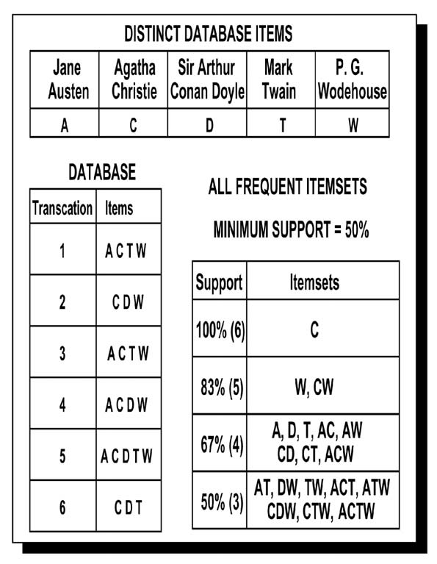
Example

Slide 20
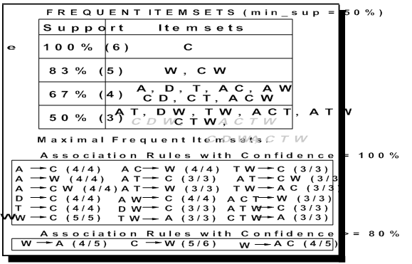
Example

Slide 21
Data Mining Algorithm for Association Rules
Task = description: associations between variables
Structure = probabilistic “association rules” (patterns)
Score function = thresholds on accuracy and support
Search method = systematic search (breadth- first with pruning)
Data management technique = multiple linear scans
Notes:
A monotonically increasing function. It is strictly increasing on the left and right while just non-decreasing in the middle
Pruning is a technique in machine learning that reduces the size of decision trees by removing sections of the tree that provide little power to classify instances.

Slide 22
Score Function
Simple Binary function
Two thresholds
p_{s} : Lower Bound on the support of the rule e.g., 0.1 => rules at least cover 10% of data
p_{a} : Lower Bound on the accuracy of the rule e.g., 0.9 => rules cover 90% of data
A pattern gets score 1 if it satisfies the thresholds else 0.
Research papers on association rule algorithms tend to emphasize computational efficiency rather than interpretation of the rules produced

Slide 23
Measuring the Information Content of a Rule

Slide 24
Data Mining Engineering

Slide 25

Assignment
Develop a program for Basic Association Rule Mining and apply it on a small dataset;
Measure the complexity empirically.
Testing:-
The same implementation will be tested (empirically) for data sets used by other groups.

